Slide 1
Week-5
COSC 32001 Computer Vision
Noopa Jagadeesh
Date: 8 Feb 2024

Slide 2
Recap
Image Segmentation using thresholding
Simple Thresholding
Otsu Thresholding
Adaptive Thresholding
Histogram Based Segmentation

Slide 3
Agenda
Image Segmentation with Watershed Algorithm
Image Blurring/Smoothing using python
Morphological transformation
Assignment#1 Student Demo

Slide 4
Critical Path
Students pick presentation topic to be presented in Week#7
Name | Topic
Vyom | Stereo Vision and Depth Estimation
Rhichard | Camera Calibration
Caleb | Pinhole and Perspective Projection
Mohsin | Segmentation using Deep learning
Elise | Color spaces in OpenCV

Slide 5
Image Segmentation with Watershed Algorithm

Slide 6
Image segmentation
Image segmentation involves partitioning an image into various segments or regions, each containing a set of pixels.
The ultimate aim is to simplify or modify the representation of an image into something more meaningful, consequently making it easier to analyze.
These techniques have been widely adopted in a multitude of applications ranging from object identification within images to medical imaging diagnostics.

Slide 7
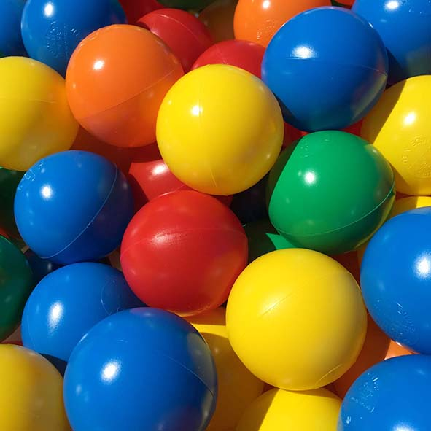
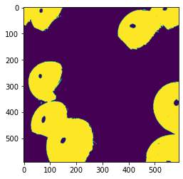
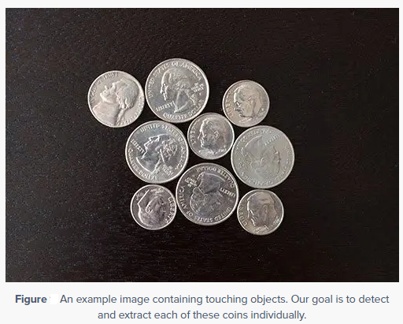
Watershed Algorithm
https://docs.opencv.org/3.4/d3/db4/tutorial_py_watershed.html
The watershed algorithm is a classic algorithm used for segmentation and is especially useful when extracting touching or overlapping objects in images, such as the balls in the figure below.
Using traditional image processing methods such as thresholding and contour detection, we would be unable to extract each individual balls from the image — but by leveraging the watershed algorithm, we are able to detect and extract each ball without a problem.
In this image you can see examples of objects that would be impossible to extract using simple thresholding and contour detection, Since these objects are touching, overlapping, or both, the contour extraction process would treat each group of touching objects as a single object rather than multiple objects.

Slide 8
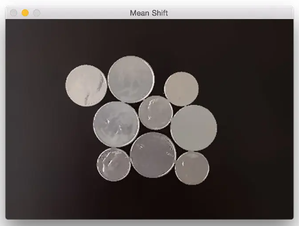
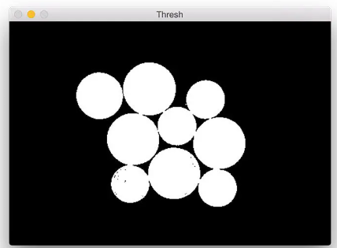
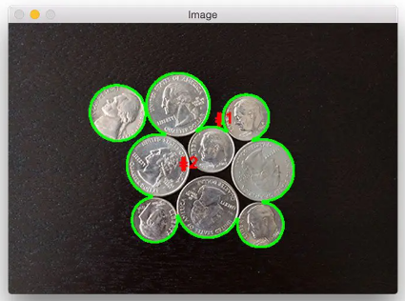
Watershed Algorithm
Pyramid mean shift filtering (image segmentation) to help the accuracy of the thresholding step.
Next threshold the mean shifted image using Otsu’s thresholding to segment the background from the foreground
The results are pretty terrible. Using simple thresholding and contour detection it reports that there are only two coins in the images, even though there are clearly nine of them.

Slide 9
Watershed Algorithm
Functions used in the code
cv2.findContours()
This function is used to detect contours in a image. Contours are simply the boundaries of objects; they are useful for shape analysis and object detection and recognition.
https://docs.opencv.org/3.4/d4/d73/tutorial_py_contours_begin.html
cv2.RETR_CCOMP: This is a flag that sets the contour retrieval mode. RETR_CCOMP retrieves all the contours and organizes them into a two-level hierarchy: external contours of the object (i.e., the boundaries of the object) are placed in one hierarchy, and the contours of holes inside the object (if any) are placed in another.
cv2.CHAIN_APPROX_SIMPLE: This flag sets the contour approximation method. CHAIN_APPROX_SIMPLE compresses horizontal, vertical, and diagonal segments and leaves only their end points. It's a way to save memory by storing only the essential points that make up the contour.
This function returns two values:
contours: A Python list of all the contours found in the image. Each contour is a numpy array of (x, y) coordinates of boundary points of the object.
hierarchy: An array containing information about the image topology. It has as many elements as the number of contours. For each contour contours[i], the hierarchy array contains four elements [Next, Previous, First_Child, Parent].

Slide 10
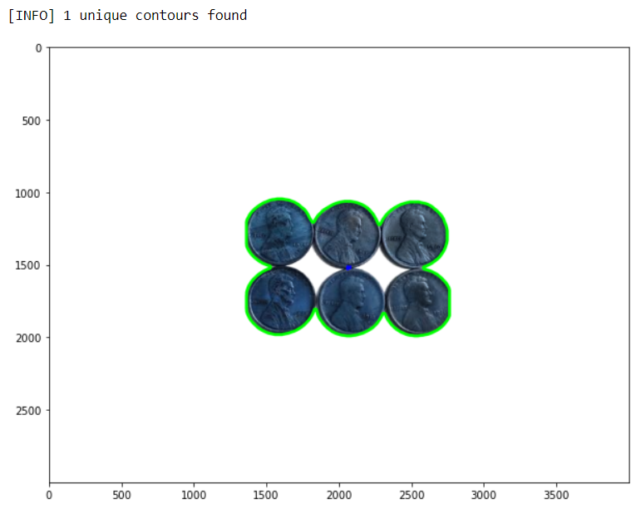
Watershed Algorithm
Functions used in the code
If hierarchy[0][i][3] == -1:
This condition checks if the current contour has no parent, which means it's an external contour. hierarchy[0][i][3] gives the parent of the ith contour. If it's -1, the contour is not enclosed by any other contour (i.e., it's an external contour).
cv2.drawContours() // This function draws the contour on the image
As we can see, our results are pretty terrible. Using simple thresholding and contour detection our Python script reports that there are only one coin in the image, even though there are clearly six of them.

Slide 11
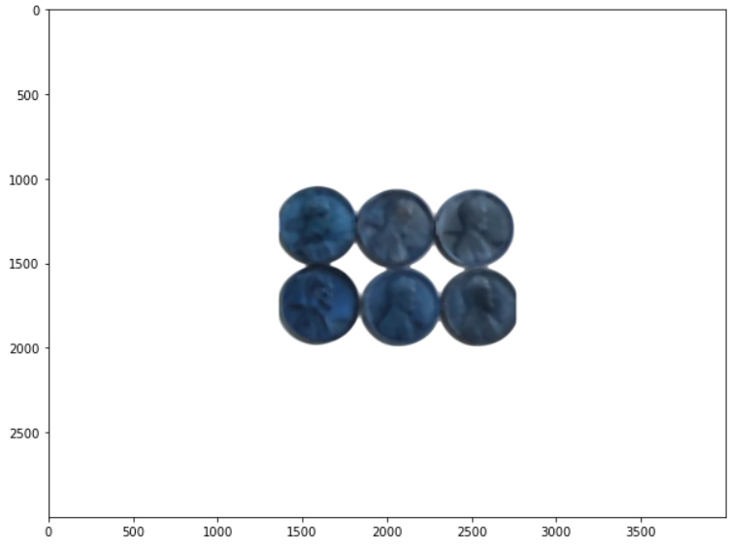
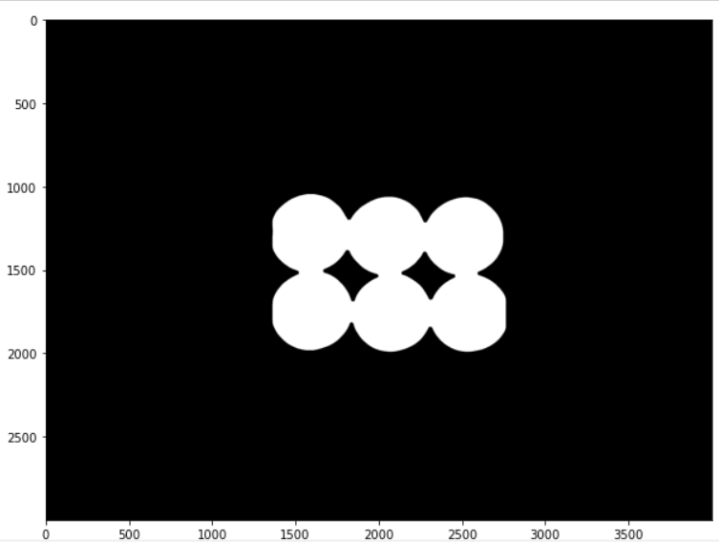
Watershed Algorithm in OpenCV
1. Thresholding: In the context of the Watershed Algorithm, thresholding plays an important role in identifying certain parts of the image. After converting the image to grayscale, the algorithm applies thresholding to the grayscale image to obtain a binary image that helps in segregating the foreground (objects to be segmented) and the background.
Original Threholded

Slide 12
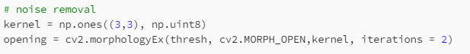
Watershed Algorithm in OpenCV
2. Opening (Erosion followed by Dilation): In this step, the opening operation, which is an erosion operation followed by a dilation operation, is performed. The purpose of this step is primarily to remove noise. The erosion operation removes small white noise in the image, but it also shrinks our objects. Following this with a dilation operation allows us to retain the size of our objects while keeping the noise out.
Let’s understand erosion and dilation
Erosion: This operation erodes away the boundaries of the foreground object. It works by creating a convolution kernel and passing it over the image. If any of the pixels in the region under the kernel are black, then the pixel in the middle of the kernel is set to black. This operation is effective at removing small white noise.
Dilation: After erosion, dilation is performed, which is essentially the opposite of erosion. It adds pixels to the boundaries of objects in an image. If any of the pixels in the region under the kernel are white, then the pixel in the middle of the kernel is set to white.

Slide 13
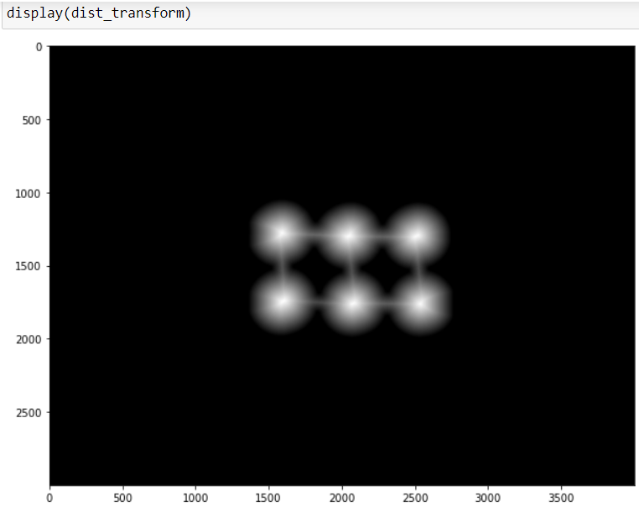
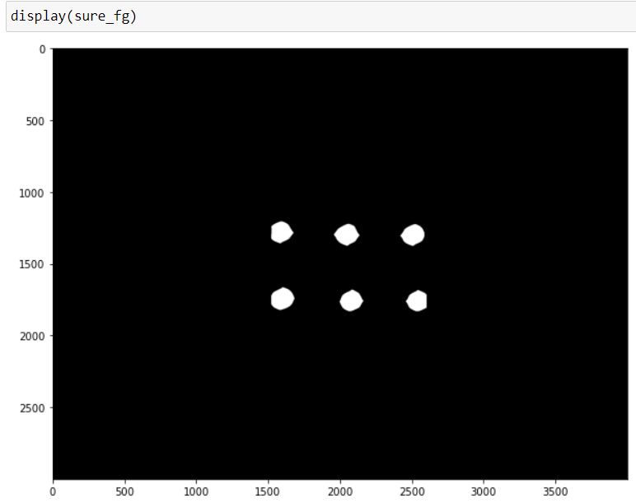
Watershed Algorithm in OpenCV
3. Distance Transformation: Watershed Algorithm involves applying a distance transform to identify regions that are likely to be the foreground.

Slide 14
Watershed Algorithm in OpenCV
Applying Distance Transform: The cv2.distanceTransform function calculates the distance from each binary image pixel to the nearest zero pixel using the cv2.DIST_L2 (Euclidean distance). The distance transform helps us identify regions that are likely to be in the foreground. The function cv2.distanceTransform(opening, cv2.DIST_L2, 5) calculates this transform.
Thresholding the Distance Transform: After calculating the distance transform, we apply thresholding to this transformed image to get the sure foreground region. The cv2.threshold(dist_transform, 0.7*dist_transform.max(), 255, 0) function call applies the thresholding. The second parameter 0.7*dist_transform.max() sets the threshold level at 70% of the maximum distance found by the distance transform. Pixels with distance transform values higher than this threshold are set as sure foreground.

Slide 15
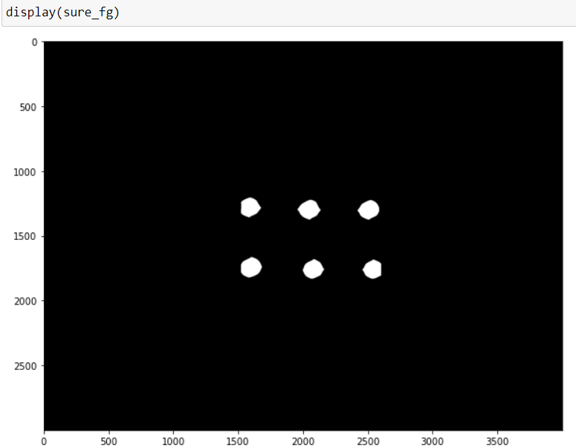
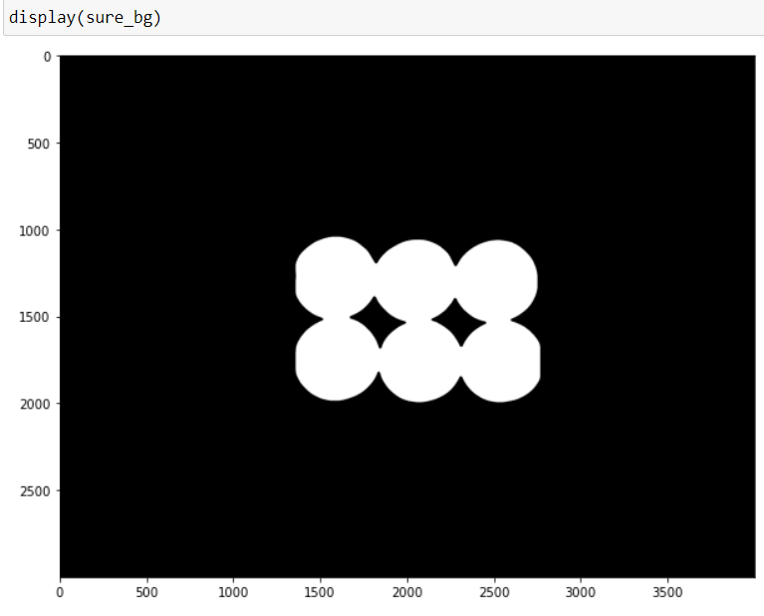
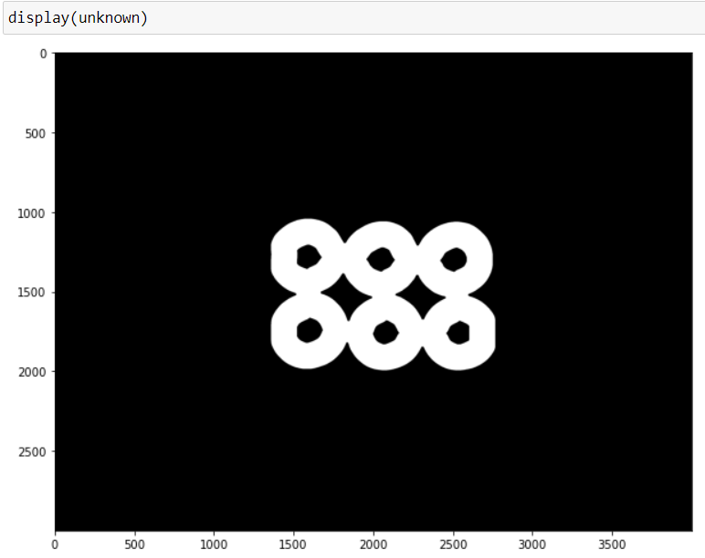
Watershed Algorithm in OpenCV
4. Identify unknown regions: We identify the unknown region, i.e., the region that is neither sure foreground nor sure background. We first convert the sure foreground (sure_fg) into an unsigned 8-bit integer. We then subtract the sure foreground from the sure background (sure_bg) to get the unknown region. The unknown region is key for the Watershed algorithm because it signifies the transition region between distinct objects or between an object and the background.

Slide 16
Watershed Algorithm in OpenCV
sure_fg (Sure Foreground): The regions occupied by the coins, or rather, the centers of the coins (due to the use of the distance transform and subsequent thresholding), would be identified as the sure foreground.
sure_bg (Sure Background): The region surrounding the coins and any areas inside the coins that are large enough not to be removed by morphological operations are marked as the sure background. Essentially, these are areas where there are no coins.
unknown (Unknown Region): These regions are neither part of the sure foreground nor the sure background. These are the regions near the edges of the coins where the algorithm is not confident enough to assign them as foreground (coins) or background (area around coins).

Slide 17
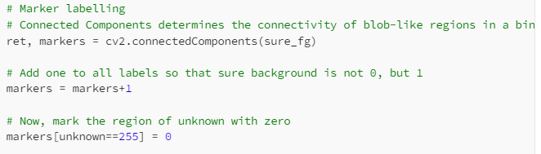
Watershed Algorithm in OpenCV
5. Label the sure_bg, sure_fg and unknown regions: This involves creating a marker and labeling the regions inside it. The regions we mark are the sure background (sure_bg), sure foreground (sure_fg), and the unknown regions. Here's the code snippet for this step.
Also, we want the sure background to be labeled differently from the sure foreground, we add 1 to all the labels in the marker image. After this operation, sure background pixels are labeled as 1, and the sure foreground pixels are labeled starting from 2.

Slide 18

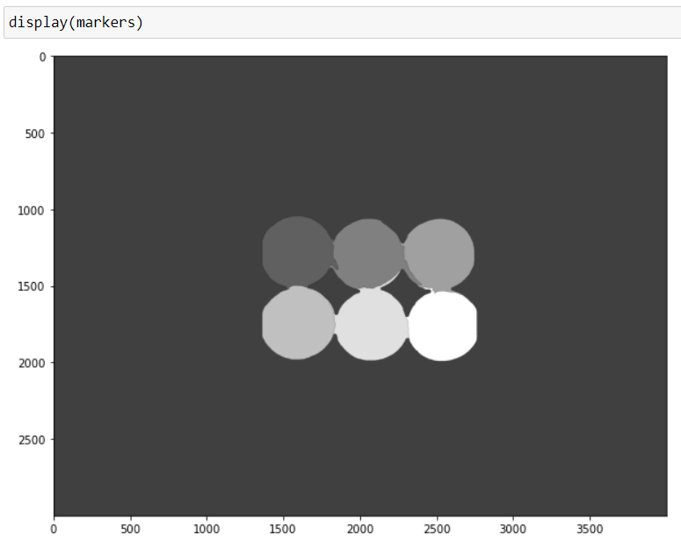
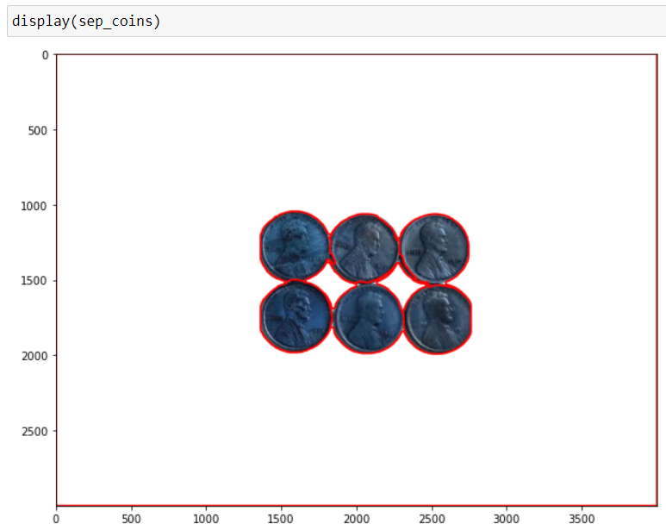
Watershed Algorithm in OpenCV

Slide 19
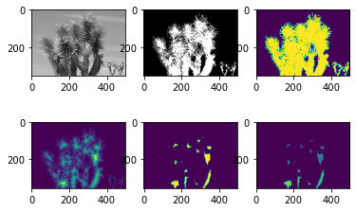
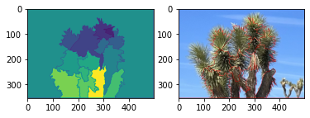
Watershed Algorithm in OpenCV

Slide 20
Image Blurring/Smoothing using python

Slide 21
Image Blurring/Smoothing using python
Smoothing and blurring is one of the most important preprocessing steps in all of computer vision and image processing.
By smoothing an image prior to applying techniques such as edge detection or thresholding we are able to reduce the amount of high-frequency content, such as noise and edges (i.e., the “detail” of an image).
While this may sound counter-intuitive, by reducing the detail in an image we can more easily find objects that we are interested in.
Blurring is a technique in digital image processing in which we perform a convolution operation between the given image and a predefined low-pass filter kernel.
So, in blurring, we simply reduce the edge content and makes the transition from one color to the other very smooth. It is useful for removing noise.
Smoothing helps us to remove noise from an image.
Sometimes we need not want all the information in an image.

Slide 22
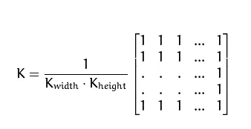
Image Blurring/Smoothing using python
1. Average blurring (cv2.blur) / (Mean or Homogeneous filter)
In averaging, we take the average of all the pixels under kernel area and replaces the central pixel with this average. The Average filter is also known as box filter, homogeneous filter, and mean filter.
To accomplish our average blur, we’ll actually be convolving our image with an M \times N normalized filter where both M and N are both odd integers.
This kernel is going to slide from left-to-right and from top-to-bottom for each and every pixel in our input image. The pixel at the center of the kernel (and hence why we have to use an odd number, otherwise there would not be a true “center”) is then set to be the average of all other pixels surrounding it.
By taking the average of the region surrounding a pixel, we are smoothing it and replacing it with the value of its local neighborhood. This allows us to reduce noise and the level of detail, simply by relying on the average.
An Average kernel has the following properties:
It must be odd ordered.
The sum of all the elements should be 1.
All the elements should be the same.

Slide 23
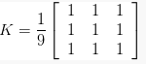
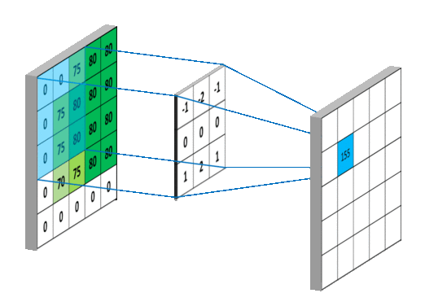
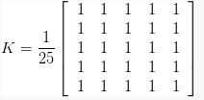
Image Blurring/Smoothing using python
1. Average blurring (cv2.blur) / (Mean or Homogeneous filter)
For example a 3 x 3 average kernel that can be used to blur the central pixel with a 3 pixel radius is:
A 5 x 5 average kernel:
5 x 5 kernel takes more pixels into account for the average, and will blur the image more than a 3 x 3 kernel since the kernel covers more area of the image.
This brings us to an important rule: as the size of the kernel increases, so will the amount in which the image is blurred.

Slide 24
Image Blurring/Smoothing using python
2. Gaussian Filtering/ Gaussian blurring ( cv2.GaussianBlur)
Gaussian blurring is similar to average blurring, but instead of using a simple mean, we are now using a weighted mean, where neighborhood pixels that are closer to the central pixel contribute more “weight” to the average.
And as the name suggests, Gaussian smoothing is used to remove noise that approximately follows a Gaussian distribution.
The end result is that our image is less blurred, but more “naturally blurred,” than using the average method. Furthermore, based on this weighting we’ll be able to preserve more of the edges in our image as compared to average smoothing.
Just like an average blurring, Gaussian smoothing also uses a kernel of M x N, where both M and N are odd integers.
The last parameter is , the standard deviation of the Gaussian distribution. By setting this value to zero, we are instructing OpenCV to automatically compute based on our kernel size.
The blur itself is more natural due to the computation of the weighted mean, rather than allowing all pixels in the kernel neighborhood to have equal weight.

Slide 25
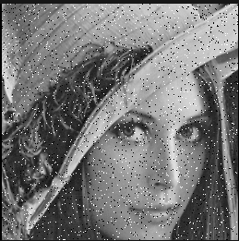
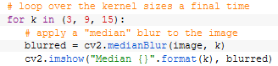
Image Blurring/Smoothing using python
3. Median blurring ( cv2.medianBlur )
Traditionally, the median blur method has been most effective when removing salt-and-pepper noise.
Using the median blur method, we could remove the salt and pepper from our image.
When applying a median blur, we first define our kernel size. Then, as in the averaging blurring method, we consider all pixels in the neighborhood of size K x K where K is an odd integer.
In average blurring and Gaussian blurring where the kernel size could be rectangular, the kernel size for the median must be square.
Furthermore (unlike the averaging method), instead of replacing the central pixel with the average of the neighborhood, we instead replace the central pixel with the median of the neighborhood.
The reason median blurring is more effective at removing salt-and-pepper style noise from an image is that each central pixel is always replaced with a pixel intensity that exists in the image. And since the median is robust to outliers, the salt-and-pepper noise will be less influential to the median than another statistical method, such as the average.
By replacing our central pixel with a median rather than an average, we can substantially reduce noise.

Slide 26
Image Blurring/Smoothing using python
4. Bilateral blurring ( cv2.bilateralFilter )
Thus far, the intention of our blurring methods have been to reduce noise and detail in an image; however, as a side effect we have tended to lose edges in the image. The previously mentioned filters will not only dissolve the noise but also smooth the edges, that make edges less sharp, even disappear.
To reduce noise while still maintaining edges, we can use bilateral blurring.
Bilateral blurring accomplishes this by introducing two Gaussian distributions.
The first Gaussian function only considers spatial neighbors. That is, pixels that appear close together in the (x, y)-coordinate space of the image. The second Gaussian then models the pixel intensity of the neighborhood, ensuring that only pixels with similar intensity are included in the actual computation of the blur.
Intuitively, this makes sense. If pixels in the same (small) neighborhood have a similar pixel value, then they likely represent the same object. But if two pixels in the same neighborhood have contrasting values, then we could be examining the edge or boundary of an object — and we would like to preserve this edge.
Overall, this method is able to preserve edges of an image, while still reducing noise. The largest downside to this method is that it is considerably slower than its averaging, Gaussian, and median blurring counterparts.

Slide 27
Image Blurring/Smoothing using python
4. Bilateral blurring ( cv2.bilateralFilter )
The first parameter we supply is the image we want to blur. Then, we need to define the diameter of our pixel neighborhood — the larger this diameter is, the more pixels will be included in the blurring computation. Think of this parameter as a square kernel size.
The third argument is our color standard deviation, denoted as sigmaColor. A larger value for sigmaColor means that more colors in the neighborhood will be considered when computing the blur. If we let sigmaColor get too large in respect to the diameter, then we essentially have broken the assumption of bilateral filtering — that only pixels of similar color should contribute significantly to the blur.
Finally, we need to supply the space standard deviation, which we call sigmaSpace. A larger value of sigmaSpace means that pixels farther out from the central pixel diameter will influence the blurring calculation.
For simplicity, we can set the 2 sigma values to be the same. If they are small (< 10), the filter will not have much effect, whereas if they are large (> 150), they will have a very strong effect, making the image look “cartoonish”.

Slide 28
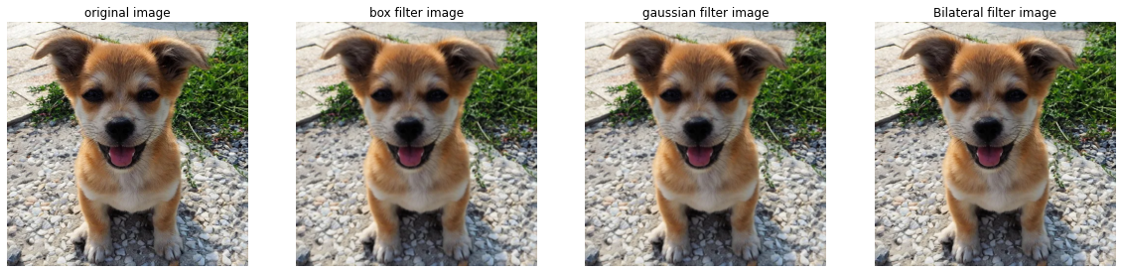

Image Blurring/Smoothing using python
kernel size: 3
kernel size: 11

Slide 29

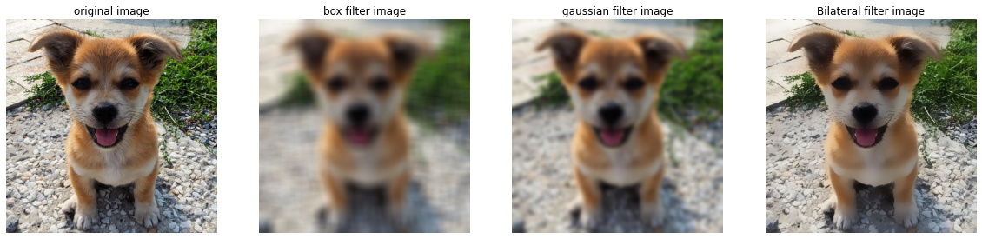
Image Blurring/Smoothing using python
kernel size: 19
kernel size: 27

Slide 30
Morphological transformation

Slide 31
Morphological transformation
Morphological operations are simple transformations applied to binary or grayscale images. More specifically, we apply morphological operations to shapes and structures inside of images.
We can use morphological operations to increase the size of objects in images as well as decrease them. We can also utilize morphological operations to close gaps between objects as well as open them.
The common morphological operations include:
Erosion
Dilation
Opening
Closing
Morphological gradient
Black hat
Top hat (also called “White hat”)

Slide 32
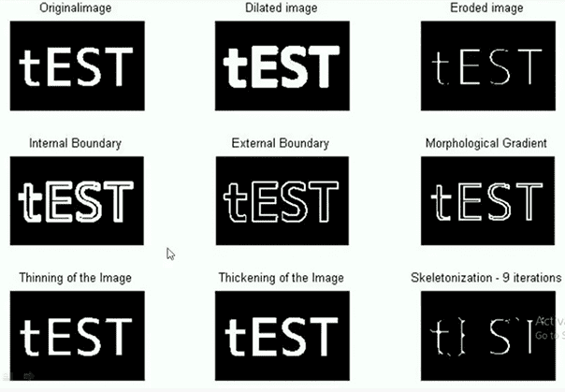
Morphological transformation
These image processing operations are applied to grayscale or binary images and are used for preprocessing for OCR algorithms, detecting barcodes, detecting license plates, and more.
And sometimes a clever use of morphological operations can allow you to avoid more complicated (and computationally expensive) machine learning and deep learning algorithms.

Slide 33
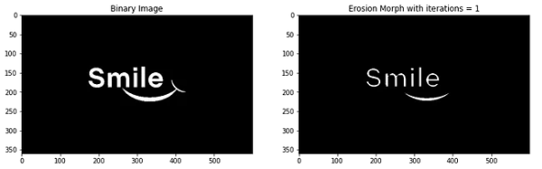
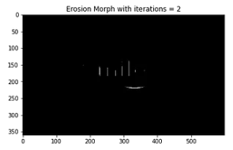
Morphological transformation
1. Erosion
An erosion in an image “erodes” the foreground object and makes it smaller. Simply put, pixels near the boundary of an object in an image will be discarded, “eroding” it away.
Erosion works by defining a structuring element and then sliding this structuring element from left-to-right and top-to-bottom across the input image.
A foreground pixel in the input image will be kept only if all pixels inside the structuring element are > 0. Otherwise, the pixels are set to 0 (i.e., background).
Erosion is useful for removing small blobs in an image or disconnecting two connected objects.
We can controls the number of times, or iterations, we are going to apply the erosion.

Slide 34
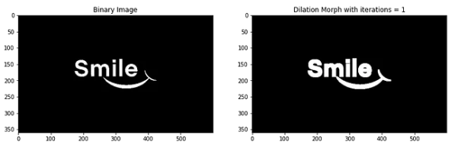
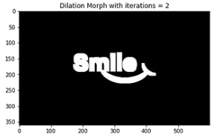
Morphological transformation
2. Dilation
The opposite of an erosion is a dilation.
Just like an erosion will eat away at the foreground pixels, a dilation will grow the foreground pixels.
Dilations increase the size of foreground objects and are especially useful for joining broken parts of an image together.
Dilations, just as an erosion, also utilize structuring elements — a center pixel p of the structuring element is set to white if ANY pixel in the structuring element is > 0.

Slide 35
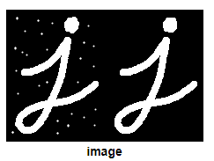
Morphological transformation
3. Opening
An opening is an erosion followed by a dilation.
Performing an opening operation allows us to remove small blobs from an image: first an erosion is applied to remove the small blobs, then a dilation is applied to regrow the size of the original object.

Slide 36
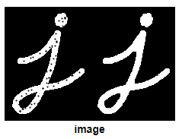
Morphological transformation
4. Closing
The exact opposite to an opening would be a closing. A closing is a dilation followed by an erosion.
As the name suggests, a closing is used to close holes inside of objects or for connecting components together.

Slide 37

Morphological transformation
5. Morphological gradient
A morphological gradient is the difference between a dilation and erosion. It is useful for determining the outline of a particular object of an image.

Slide 38
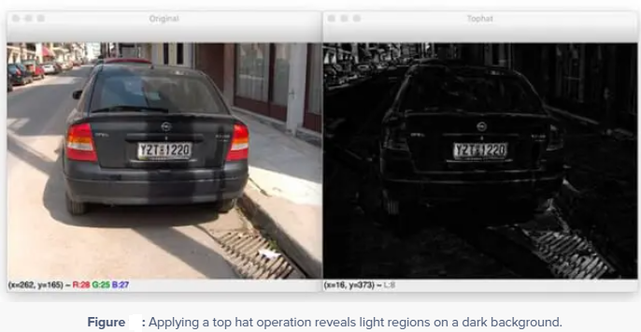
Morphological transformation
6. Top hat/white hat and black hat
A top hat (also known as a white hat) morphological operation is the difference between the original (grayscale/single channel) input image and the opening.
A top hat operation is used to reveal bright regions of an image on dark backgrounds.
Up until this point we have only applied morphological operations to binary images. But we can also apply morphological operations to grayscale images as well. In fact, both the top hat/white hat and the black hat operators are more suited for grayscale images rather than binary ones.
Notice how the right (i.e., the top hat/white hat) regions that are light against a dark background are clearly displayed — in this case, we can clearly see that the license plate region of the car has been revealed.
But also note that the license plate characters themselves have not been included. This is because the license plate characters are dark against a light background.
To help remedy that, we can apply a black hat operator

Slide 39
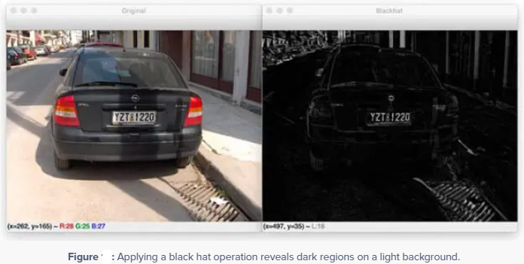
Morphological transformation
To reveal our license plate characters you would first segment out the license plate itself via a top hat operator and then apply a black hat operator (or thresholding) to extract the individual license plate characters (perhaps using methods like contour detection).

Slide 40
Disclaimer
Due to nature of the course, various materials have compiled from different open source resources with some moderation. I sincerely acknowledge their hard work and contribution

Slide 41


